Slide 1
Chapter 1:
Introduction to the World of Computers

Slide 2
Computers in Your Life
Before 1980
Computers were large, expensive
Very few people had access to them
Computers were mostly used for high-volume processing tasks
Microcomputers in the early 80s
Inexpensive personal computers
Computer use increased dramatically

Slide 3
Computers in Your Life
Today
More than 80% of US households include a computer, and most use computers at work
Electronic devices are converging into single units with multiple capabilities
Computer is no longer an isolated productivity tool
Check e-mail on living room television
View internet content on mobile phone or other mobile device
Computer literacy
Knowing about and understanding computers and their uses is an essential skill for everyone

Slide 4
Computers in the Home
Computers used for a variety of tasks:
Looking up information and news
Exchanging e-mail
Shopping and paying bills
Watching TV and videos
Downloading music and movies
Organizing digital photographs
Playing games
Making vacation plans

Slide 5
Computers in the Home
Wireless networking
Computers can be used in nearly any location
Smart appliances
Traditional appliances with built-in computer or communication technology
Smart homes
Household tasks are monitored and controlled by a main computer in the house

Slide 6
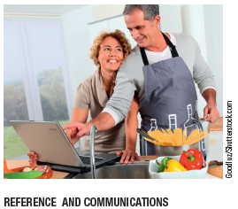
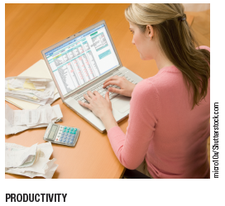
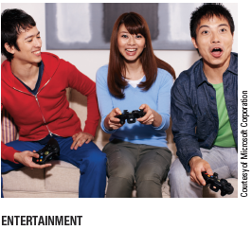
Computers in the Home

Slide 7
Computers in Education
Youth today can be called the computing generation
Most students today have access to computers at school
Some schools integrate e-books into the curriculum
Colleges and universities are even more integrated
Wireless hotspots allow usage of personal laptops to connect to the college network
Some colleges require a computer for enrollment
Distance learning
Students participate from locations other than the traditional classroom setting using computers and Internet access

Slide 8
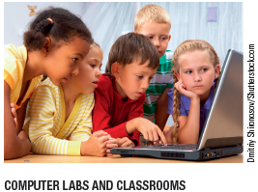
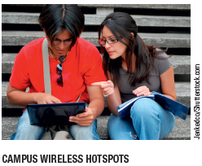
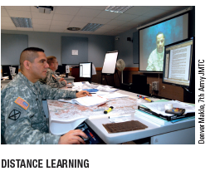
Computers in Education

Slide 9
Computers on the Job
Computers have become a universal on-the-job tool for decision-making, productivity, and communication
Used by all types of employees
Used for access control and other security measures
Use by service professionals is growing
Used extensively by the military
Employees in all lines of work need to continually refresh their computer skills

Slide 10
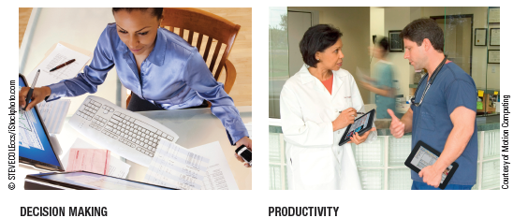
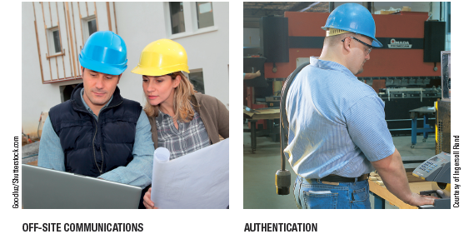
Computers on the Job

Slide 11
Computers on the Go
Computers are encountered in nearly every aspect of daily life
Consumer kiosks
ATM transactions
POS systems at retail stores
Self-checkout systems
Consumer authentication systems
Portable computers or mobile devices
GPS systems

Slide 12
What Is a Computer and What Does It Do?
Computer
A programmable, electronic device that accepts data, performs operations on that data, and stores the data or results as needed
Computers follow instructions, called programs, which determine the tasks the computer will perform
Basic operations
Input: Entering data into the computer
Processing: Performing operations on the data
Output: Presenting the results
Storage: Saving data, programs, or output for future use
Communications: Sending or receiving data

Slide 13
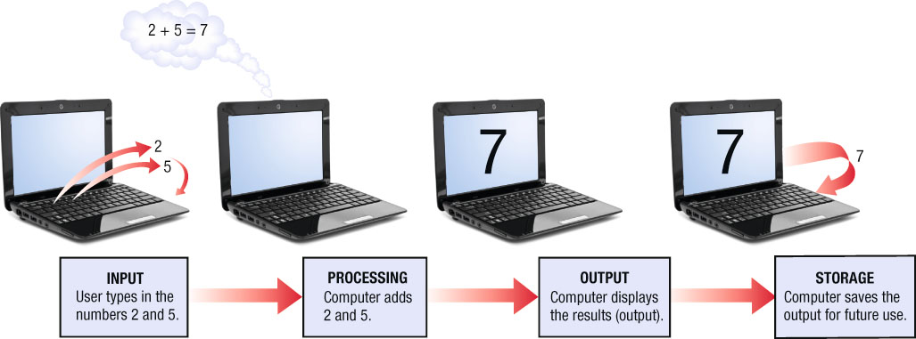
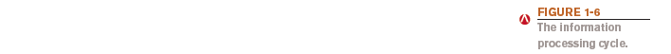
What Is a Computer and What Does It Do?

Slide 14
Data vs. Information
Data
Raw, unorganized facts
Can be in the form of text, graphics, audio, or video
Information
Data that has been processed into a meaningful form
Information processing
Converting data into information

Slide 15
Computers Then and Now
The computer as we know it is a fairly recent invention
The history of computers is often referred to in terms of generations
Each new generation is characterized by a major technological development
Precomputers and early computers (before 1946)
Abacus, slide rule, mechanical calculator
Punch Card Tabulating Machine and Sorter

Slide 16
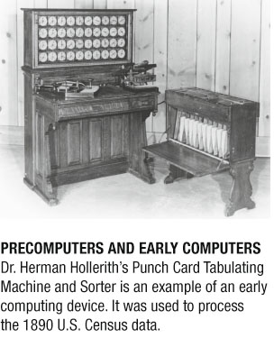
Computers Then and Now

Slide 17
Computers Then and Now
First-generation computers (1946-1957)
Enormous and powered by vacuum tubes
Used a great deal of electricity and generated a lot of heat
ENIAC and UNIVAC
Second-generation computers (1958-1963)
Used transistors
Computers were smaller, more powerful, cheaper, more energy-efficient, and more reliable
Punch cards and magnetic tape were used to input and store data

Slide 18
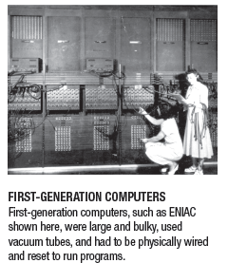
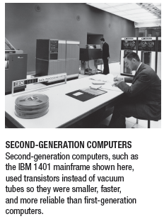
Computers Then and Now

Slide 19
Computers Then and Now
Third-generation computers (1964-1970)
Used integrated circuits (ICs)
Keyboards and monitors introduced
Fourth-generation computers (1971-present)
Use microprocessors
IBM PC, Apple Macintosh
Use keyboards, mice, monitors, and printers
Use magnetic disks, flash memory, and optical disks for storage
Computer networks, wireless technologies, Internet introduced

Slide 20
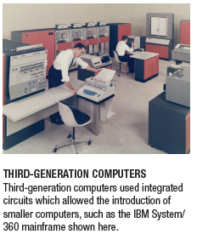
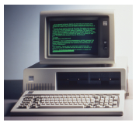
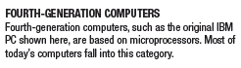
Computers Then and Now

Slide 21
Computers Then and Now
Fifth-generation (now and the future)
Infancy stage
No precise classification
May be based on artificial intelligence (AI)
Will likely use voice and touch input
May be based on optical computers and utilize nanotechnology

Slide 22
Hardware
Hardware: The physical parts of a computer
Internal hardware
Located inside the main box (system unit) of the computer
External hardware
Located outside the system unit
Connect to the computer via a wired or wireless connection
Hardware devices are associated with all five computer operations

Slide 23
Hardware
Input devices
Used to input data into the computer
Keyboards, mice, scanners, cameras, microphones, joysticks, touch pads, touch screens, fingerprint readers, etc.
Processing devices
Perform calculations and control computer’s operation
Central processing unit (CPU) and memory
Output devices
Present results to the user
Monitors, printers, speakers, projectors, etc.

Slide 24
Hardware
Storage devices
Used to store data on or access data from storage media
Hard drives, CD/DVD discs and drives, USB flash drives, etc.
Communications devices
Allow users to communicate with others and to electronically access remote information
Modems, network adapters, etc.

Slide 25
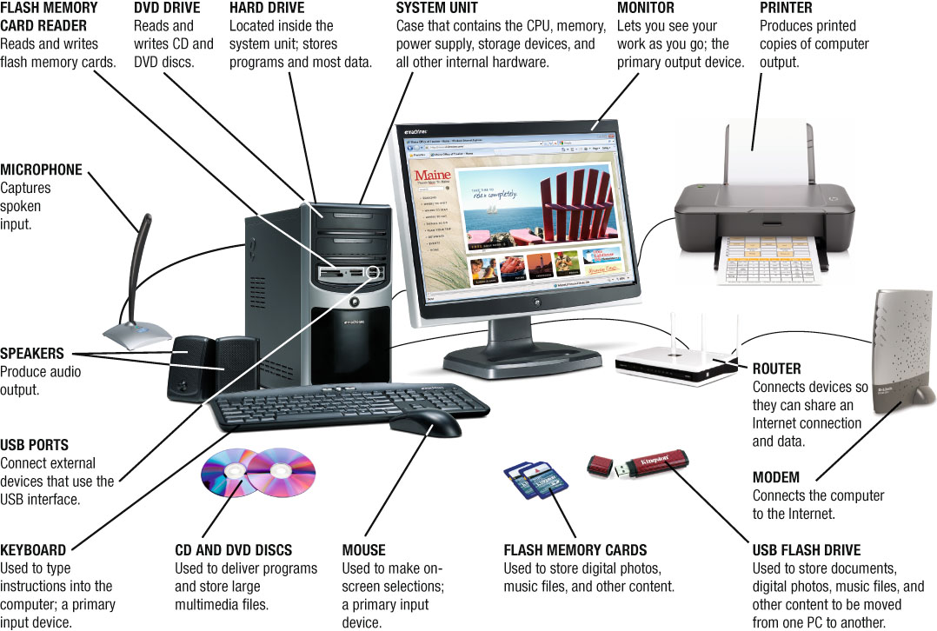
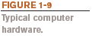
Hardware

Slide 26
Software
Software
The programs or instructions used to tell the computer hardware what to do
System software
Operating system starts up the computer and controls its operation
Without OS, computer cannot function
Boots the computer and launches programs at the user’s direction
Most use a GUI to interact with the user via windows, icons, menus, buttons, etc.
Windows, Mac OS, Linux, etc.

Slide 27
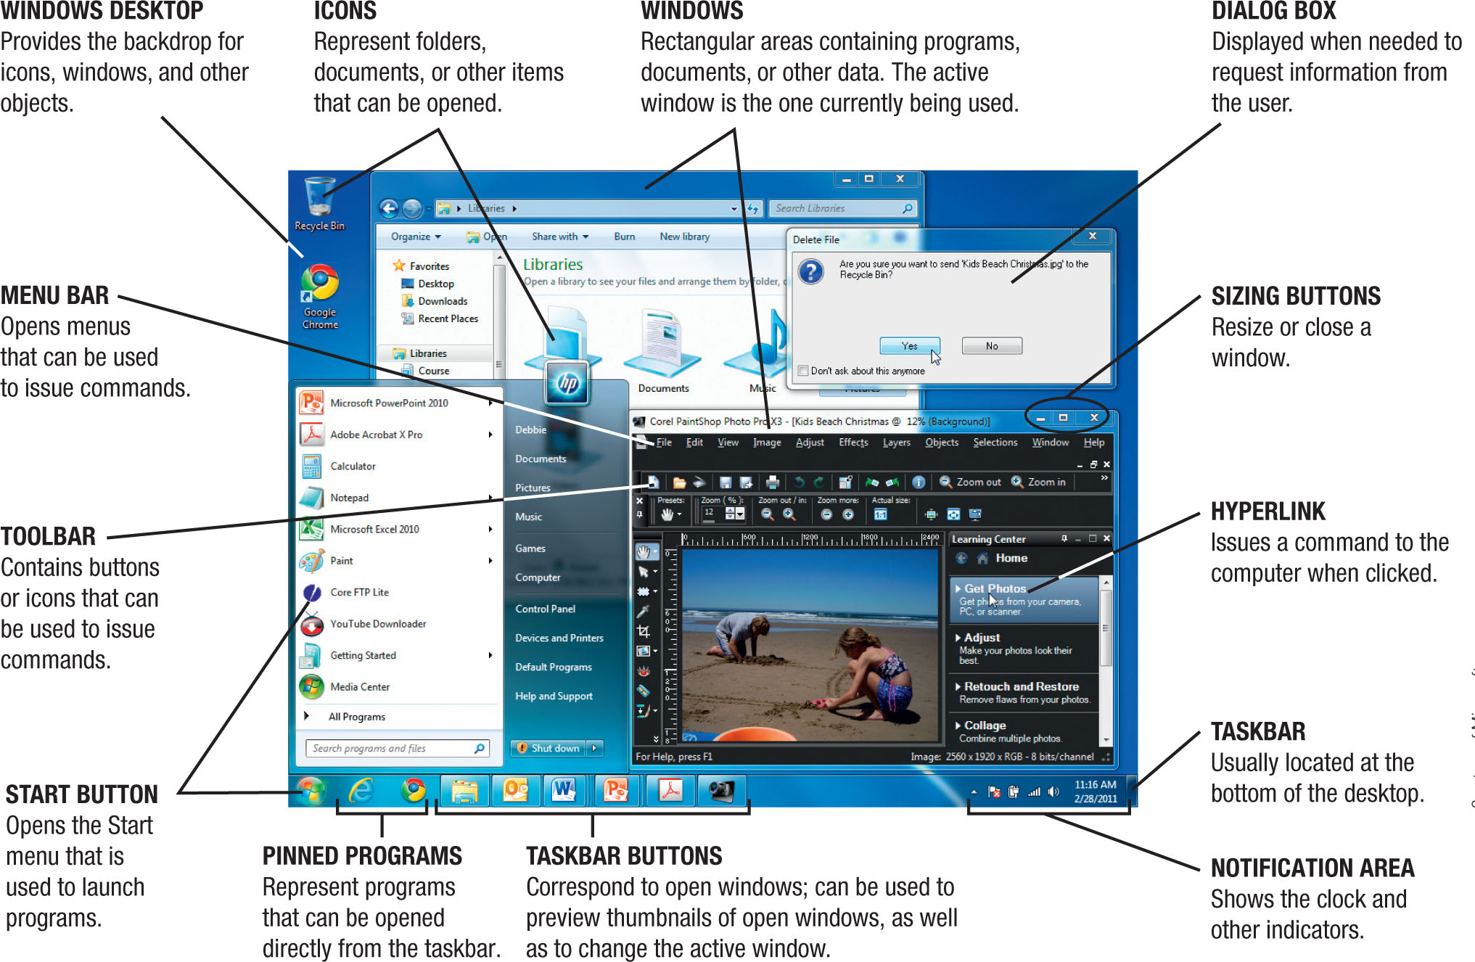

Software

Slide 28
Application Software
Application software
Performs specific tasks or applications
Creating letters, budgets, etc.
Managing inventory and customer databases
Editing photographs
Scheduling appointments
Viewing Web pages
Sending and receiving e-mail
Recording/playing CDs and DVDs
Designing homes
Playing games

Slide 29
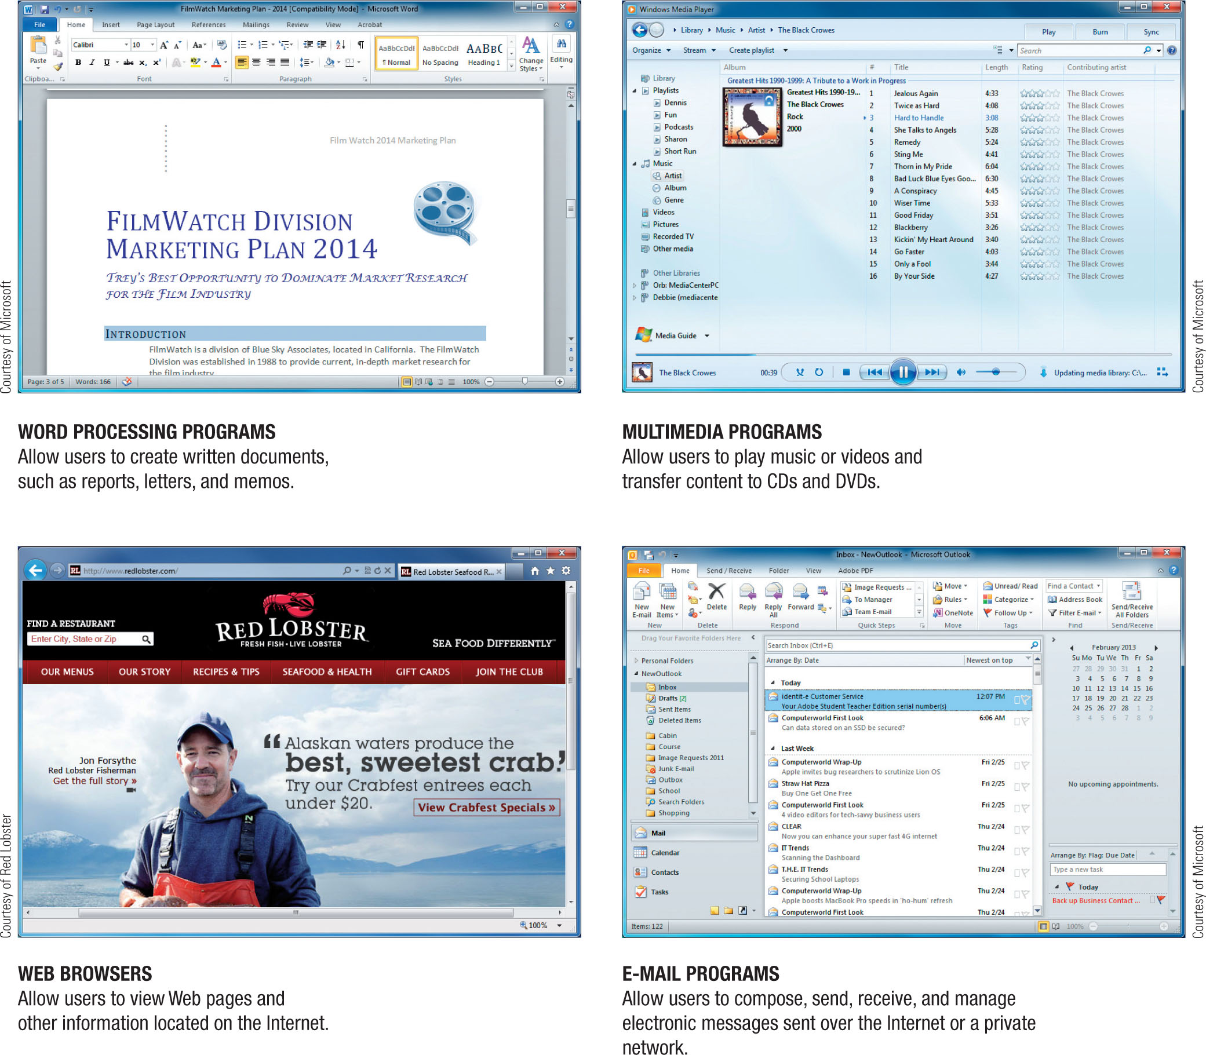
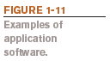
Application Software

Slide 30
Application Software

Slide 31
Computer Users and Professionals
Computer users (end users)
People who use a computer to obtain information
Computer professionals include:
Programmers
Write programs computers use
Systems analysts
Design computer systems
Computer operations personnel
Manage day-to-day computer operations
Security specialists
Secure computers and networks against hackers

Slide 32
Quick Quiz
1. Which of the following was not a first generation computer?
a. IBM PC
b. UNIVAC
c. ENIAC
2. True or False: A window displayed when the computer needs more information from the user is called a dialog box.
3. Speakers are an example of a(n) _____________ device.
Answers:
1) a; 2) True; 3) output

Slide 33
Computers To Fit Every Need
Six basic categories of computers:
Embedded computers
Mobile devices
Personal computers
Midrange servers
Mainframe computers
Supercomputers

Slide 34
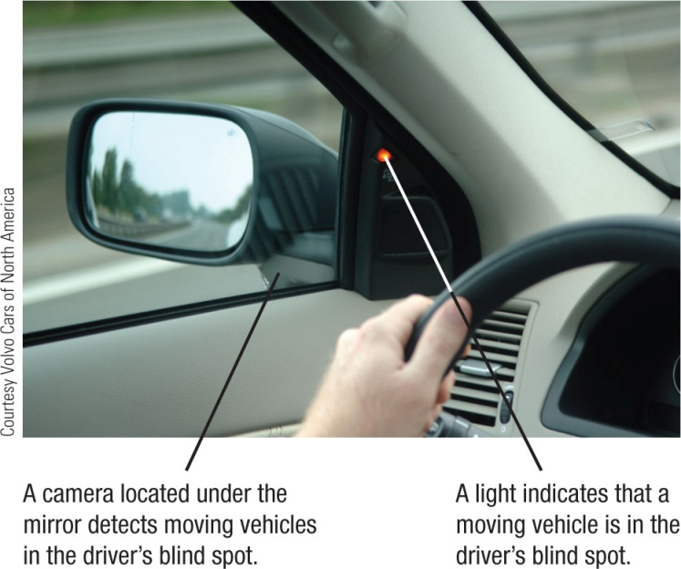
Embedded Computers
Embedded computer
Embedded into a product and designed to perform specific tasks or functions for that product
Cannot be used as general-purpose computers
Often embedded into:
Household appliances
Thermostats
Sewing machines
A/V equipment
Answering machines
Cars

Slide 35
Mobile Devices
Mobile device
A very small device with some type of built-in computing or Internet capability
Often based on a mobile phone
Typically have small screens and keyboards
Examples:
Smartphones
Handheld gaming devices
Portable digital media players
Mobile tablets

Slide 36

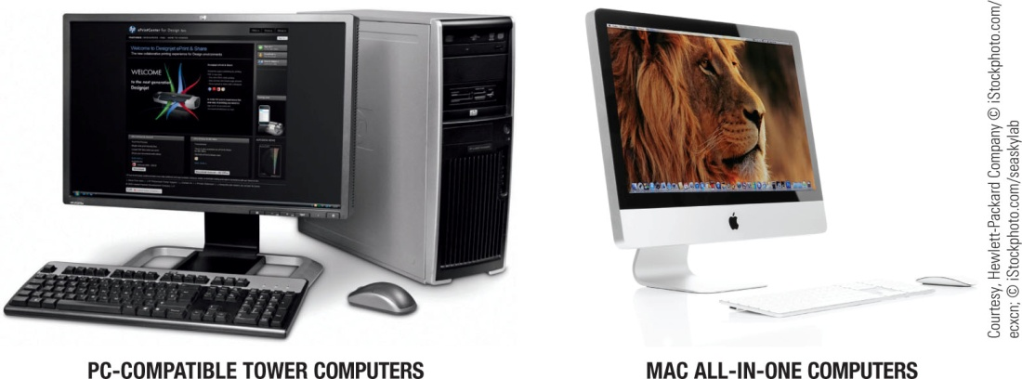
Personal Computers
Personal computer
Small computer designed to be used by one person at a time
Also called a microcomputer
Available in different sizes and shapes
Desktop computers
Fit on or next to a desk
Can use tower case, desktop case, or all-in-one
Can be PC- compatible or Macintosh
Not designed to be portable

Slide 37
Portable Computers
Portable Computers
Designed to be carried around easily
Fully functional computers
Notebook (laptop) computers
Typically use a clamshell design
Tablet Computers
Usually use a digital pen/stylus or touch screen
Can be slate or convertible tablets

Slide 38

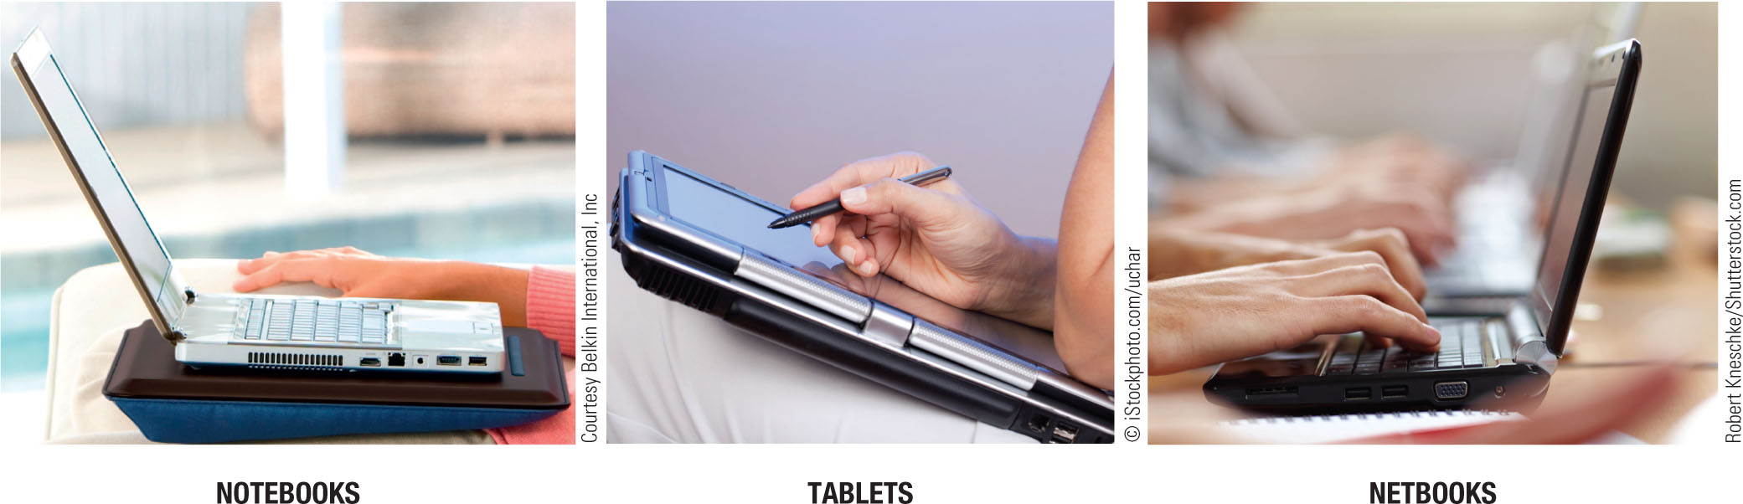
Portable Computers
Netbooks
Smaller, lighter, and less expensive than conventional notebooks
Longer battery life
Good for students and business travelers

Slide 39
Thin Client and Internet Appliances
Thin client or network computer (NC)
Device designed to access a network for processing and data storage
Lower cost, increased security and easier maintenance
Limited or no local storage
Not able to function as a computer if network is down
Internet appliance
Specialized network computer designed for Internet access and/or e-mail exchange
Some designed to be used in the home

Slide 40
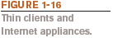
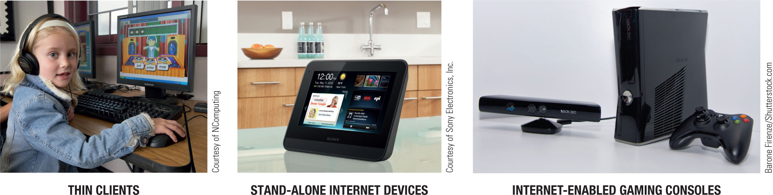
Thin Client and Internet Appliances
Can be built into another product such as a refrigerator or telephone console
Can be a stand-alone device
Can include Internet-enabled gaming consoles

Slide 41

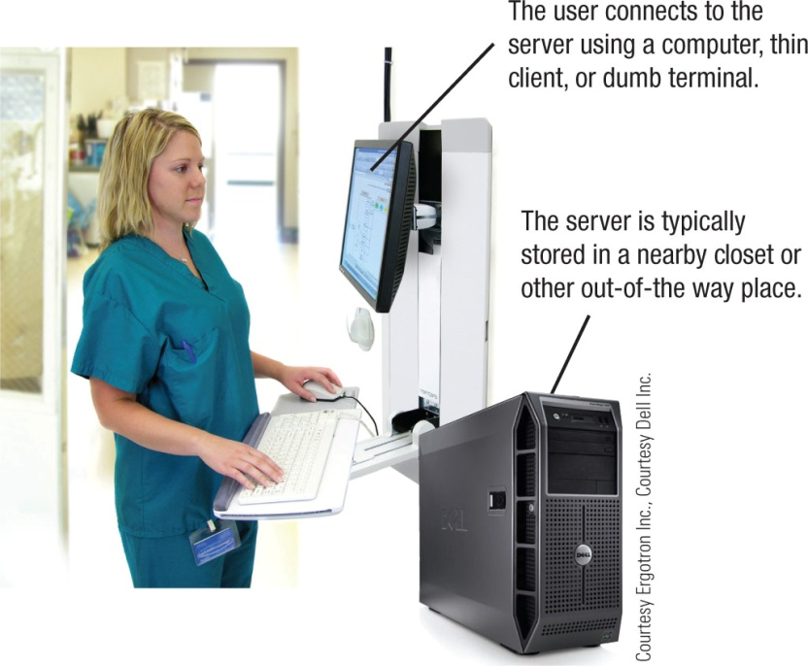
Midrange Servers
Midrange server
A medium-sized computer used to host programs and data for a small network
Sometimes referred to as a microcomputer
Users connect via a network with a computer, thin client, or dumb terminal
May consist of a collection of individual circuit boards called blades
Virtualization
Creating virtual rather than actual environments (often used to share a server for increased efficiency)

Slide 42
Mainframe Computers
Mainframe computer
Powerful computer used by many large organizations to manage large amounts of centralized data
Standard choice for hospitals, universities, large businesses, banks, government offices
Located in climate-controlled data centers and connected to the rest of the company computers via a network
Larger, more expensive, and more powerful than midrange servers
Usually operate 24 hours a day
Also called high-end servers or enterprise-class servers

Slide 43
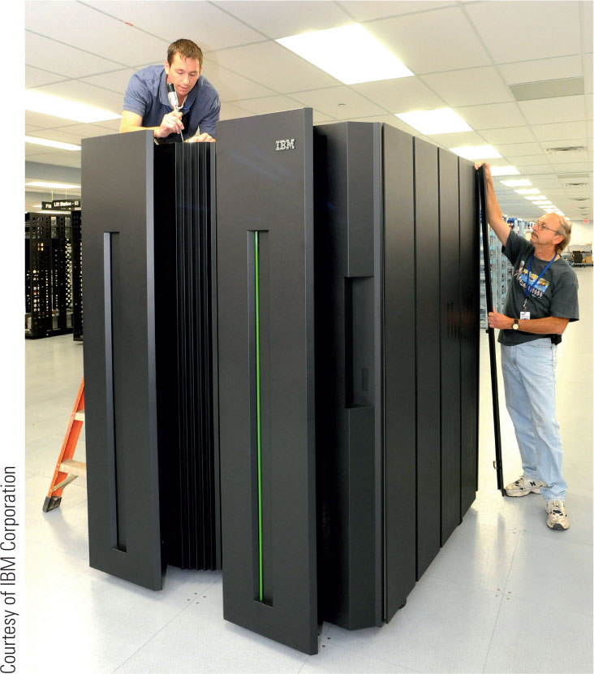
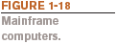
Mainframe Computers

Slide 44
Supercomputers
Supercomputer
Fastest, most expensive, most powerful type of computer
Generally run one program at a time, as fast as possible
Commonly built by connecting hundreds of smaller computers, supercomputing cluster
Used for space exploration, missile guidance, satellites, weather forecast, oil exploration, scientific research, complex Web sites, decision support systems, 3D applications, etc.

Slide 45
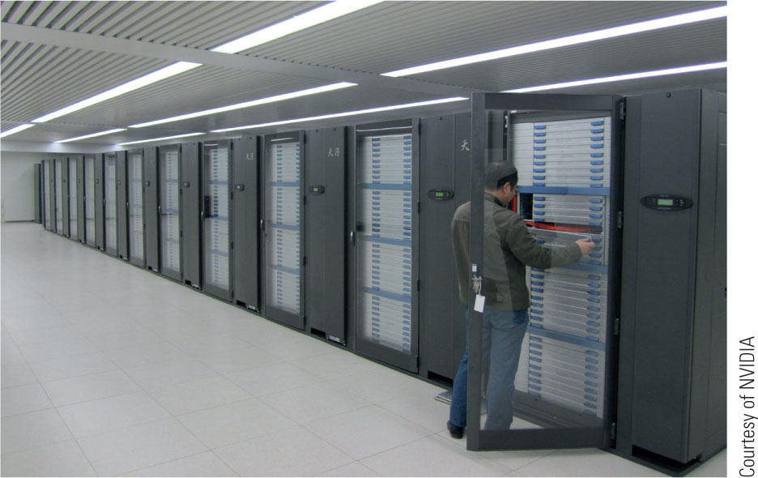

Supercomputers

Slide 46
Quick Quiz
1. A tablet PC is an example of a(n) _____________.
a. Desktop computer
b. Portable PC
c. Internet appliance
2. True or False: The terms mainframe computer and supercomputer are interchangeable; both refer to the largest, most powerful computers.
3. A smartphone is an example of a(n) _____________.
Answers:
1) b; 2) False; 3) mobile device

Slide 47
Computer Networks and the Internet
Computer network
A collection of hardware and other devices that are connected together
Users can share hardware, software, and data
Users can communicate with each other
Network servers
Manage resources on a network

Slide 48
Computer Networks and the Internet
Computer networks exist in many sizes and types
Home networks
School and small business networks
Large corporate
Public wireless networks
The Internet

Slide 49
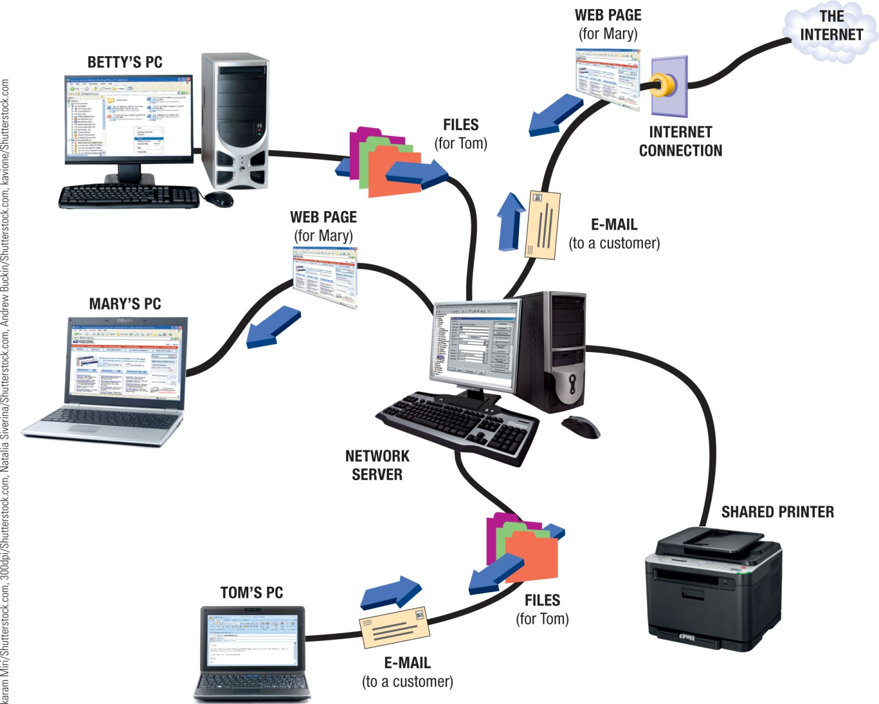
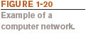
Computer Networks and the Internet

Slide 50
What are the Internet and the World Wide Web?
Internet
The largest and most well-known computer network in the world
Individuals connect to the Internet using an Internet service provider (ISP)
World Wide Web
One resource (a vast collection of Web pages) available through the Internet
Web sites contain Web pages stored on Web servers
Web pages viewed using a Web browser (Internet Explorer, Chrome, Safari, Firefox, Opera, etc.)
A wide variety of information is available through the Web

Slide 51
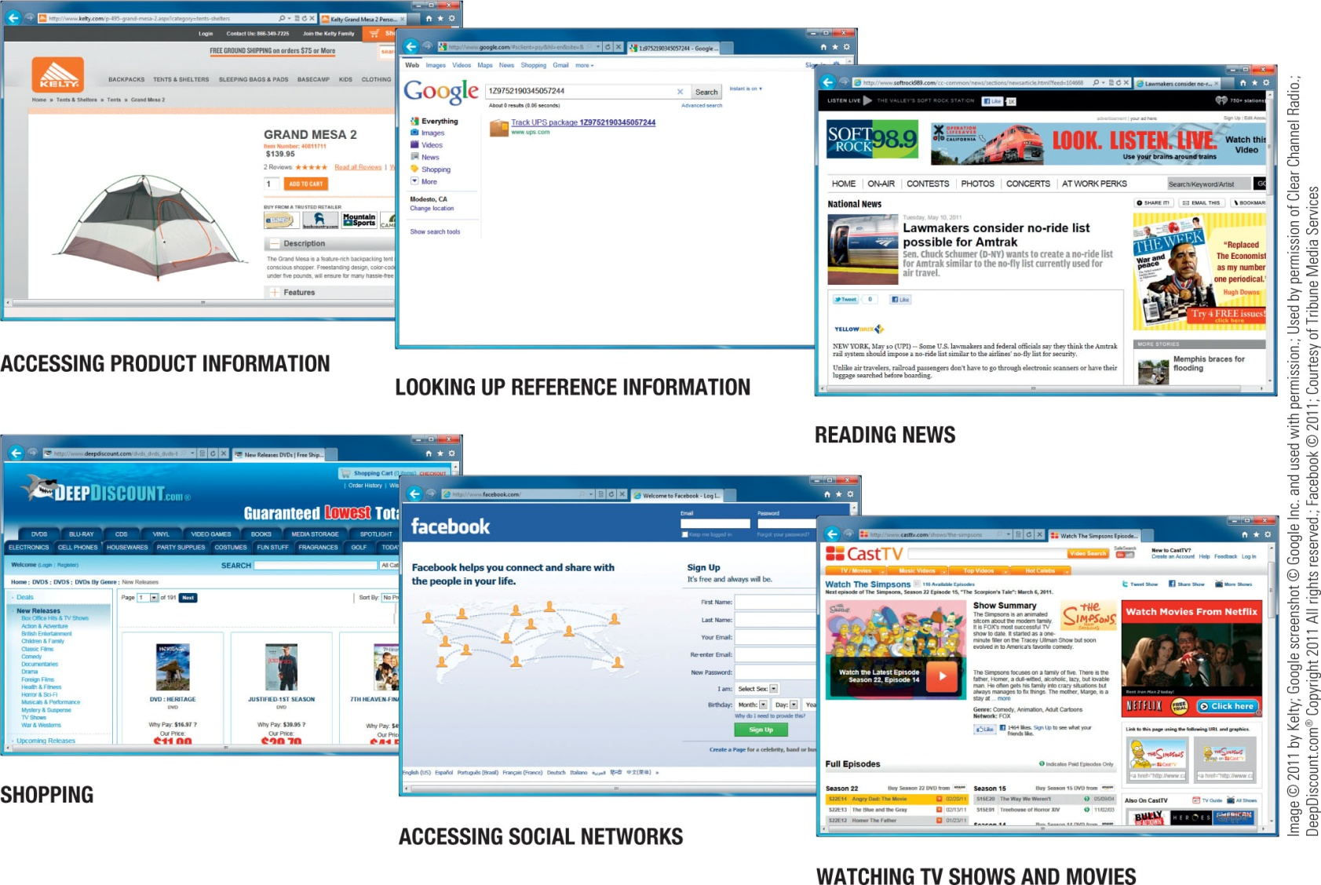

What are the Internet and the World Wide Web

Slide 52
Accessing a Network or the Internet
Need a modem or network adapter to connect
Some networks require a username and password
Internet connections can be:
Direct (always-on) connections
Dial-up connections
Internet addresses are used to access resources on the Internet
IP (Internet Protocol) address
Numeric address that identifies computers (207.46.197.32)

Slide 53
Accessing a Network or the Internet
IP addresses and domain names
Text-based address that identifies computers (microsoft.com)
Uniform resource locators (URLs)
Identify Web pages (http://twitter.com/jobs/index.html)
E-mail addresses
Identifies people for e-mail exchange (jsmith@cengage.com)

Slide 54
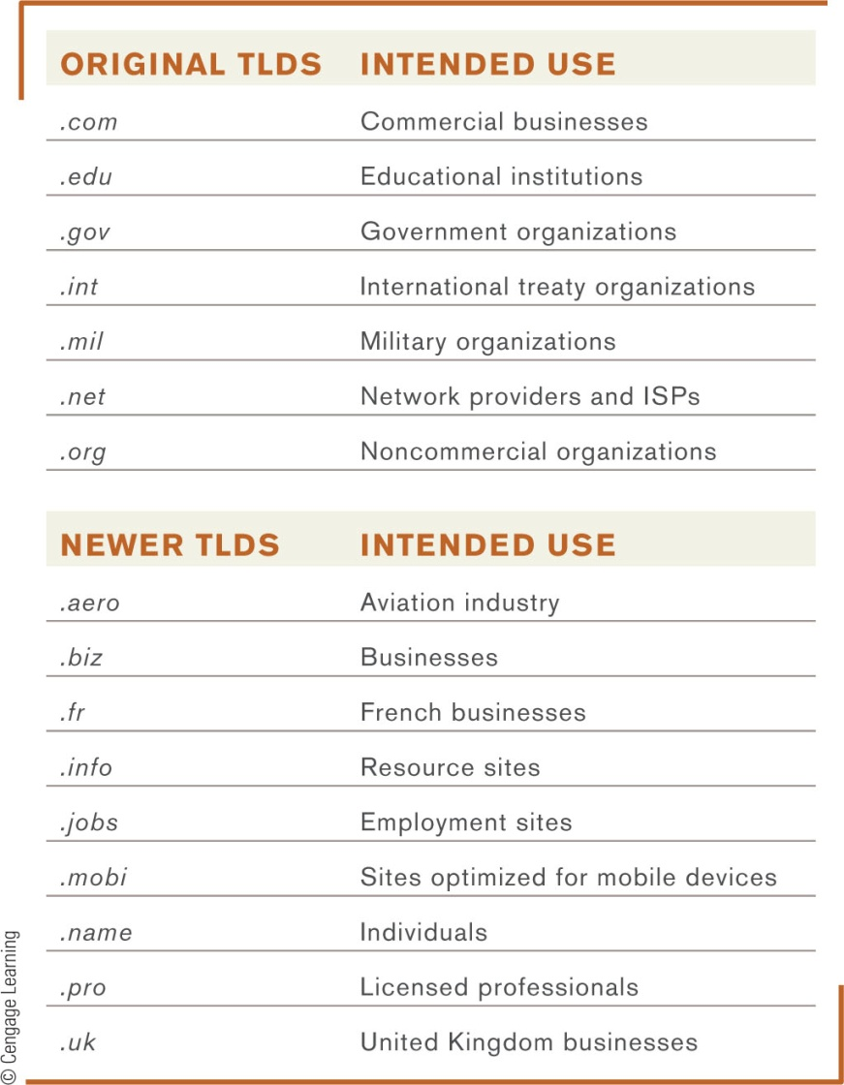
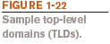
IP Addresses and Domain Names
IP addresses are numeric and unique
Domain names
Correspond to IP addresses
Top-level domains (TLDs)
identifies type of organization
or its location
Custom TLDs may soon be allowed

Slide 55
Uniform Resource Locators (URLs)
Uniform Resource Locators (URLs)
Uniquely identifies a Web page
Protocol or standard being used
Identification of the Web server
Names of folders in which the Web page file is stored
Web page’s filename

Slide 56
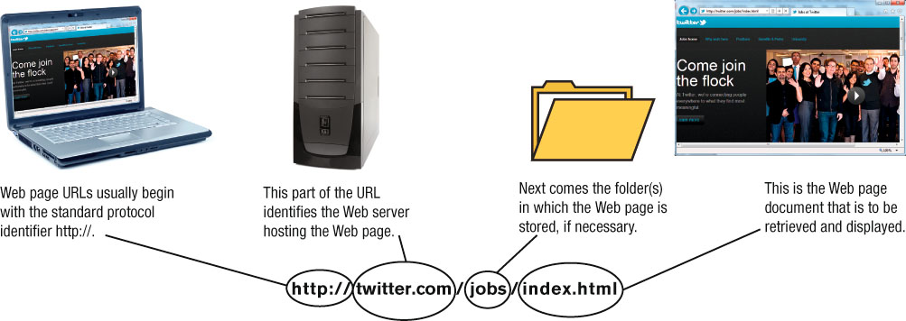
Uniform Resource Locators (URLs)
Protocols:
Hypertext Transfer Protocol (http://) is typically used to display Web pages (https:// is used for secure Web pages)
File Transfer Protocol (ftp://) is often used for file exchange

Slide 57
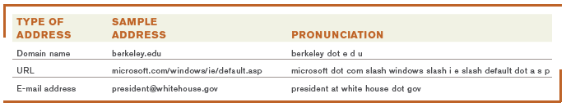
E-mail Addresses
E-mail addresses consist of:
Username
A person’s identifying name for a particular domain
The @ symbol
Domain name for the computer that will be handling the person’s e-mail (mail server)
Pronouncing Internet addresses

Slide 58
Surfing the Web
Web browser
Used to display Web pages
Browser starting page or home page
The first page displayed when the browser is opened
To navigate to a Web page, you can:
Type a URL in the Address bar
Click a hyperlink –graphics or text linked to other Web pages
Select a Favorite/Bookmark or page from the History list

Slide 59
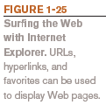
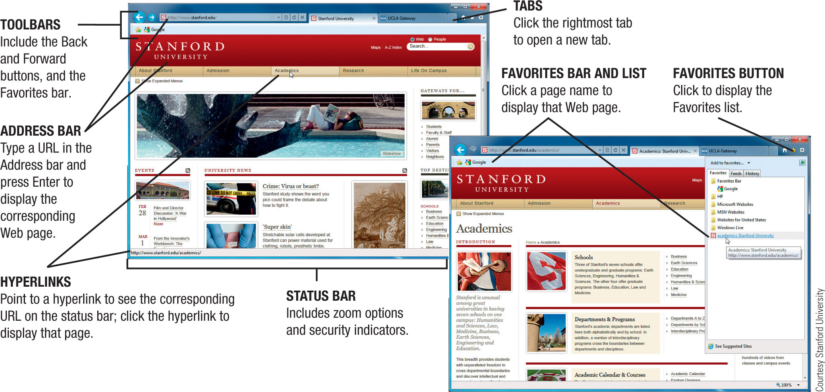
Surfing the Web

Slide 60
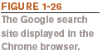
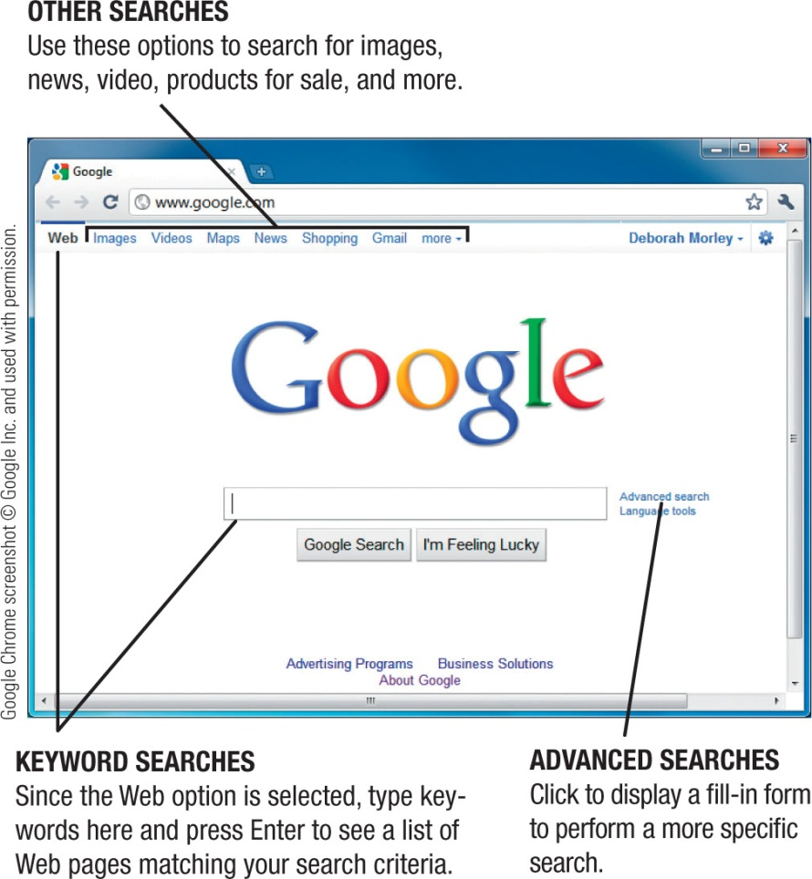
Searching the Web
Search site:
Web page that helps you find Web pages containing the information you are seeking
Typically search using keywords
Reference Sites
Look up addresses, telephone numbers, ZIP codes, maps, etc.

Slide 61
E-Mail
Electronic mail (e-mail)
Electronic messages exchanged between computers on a network
One of the most widely used Internet applications
Can be conventional e-mail program, Web-based, or mobile-based
Conventional Web-based
Microsoft Outlook Gmail
Microsoft Mail Windows Live Mail

Slide 62
E-Mail
Can contain photos, attached files, etc.
Mobile e-mail may require a fee
Other types of mobile communications
Short Message Service (SMS)
Multimedia Message Service (MMS)

Slide 63
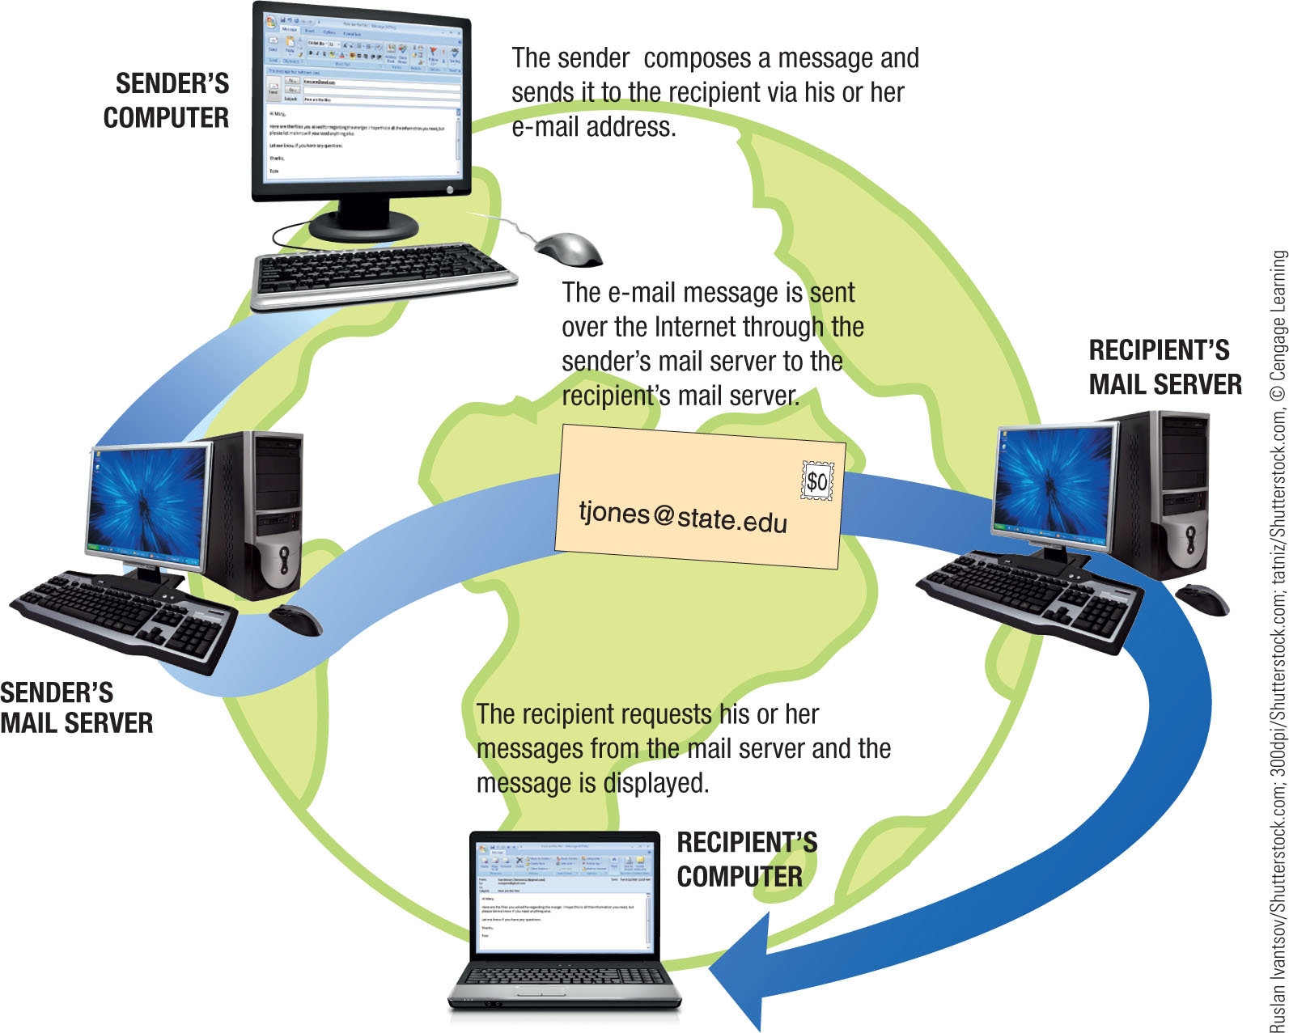

E-Mail

Slide 64
Computers and Society
The vast improvements in technology over the past decade have had a distinct impact on daily life, both at home and at work
Many benefits of a computer-oriented society
Ability to design products before construction leads to safer products
Earlier medical diagnoses and more effective treatment
Devices that allow physically and/or visually challenged individuals to perform job tasks
Documents e-mailed or faxed in moments
Download information, music, programs, movies, and more on demand

Slide 65
Computers and Society
Computer-oriented society also has risks
Stress and health concerns
Spam
Computer viruses and malware
Identity theft and phishing
Privacy issues
How data is collected
How secure is the collected data

Slide 66
Computers and Society
Differences in online communications
Less formal than traditional
Netiquette
Be polite and considerate of others
Refrain from offensive remarks
Abbreviations (acronyms) and emoticons
Acronyms such as BTW (by the way)
Illustrations of faces-- ☺

Slide 67
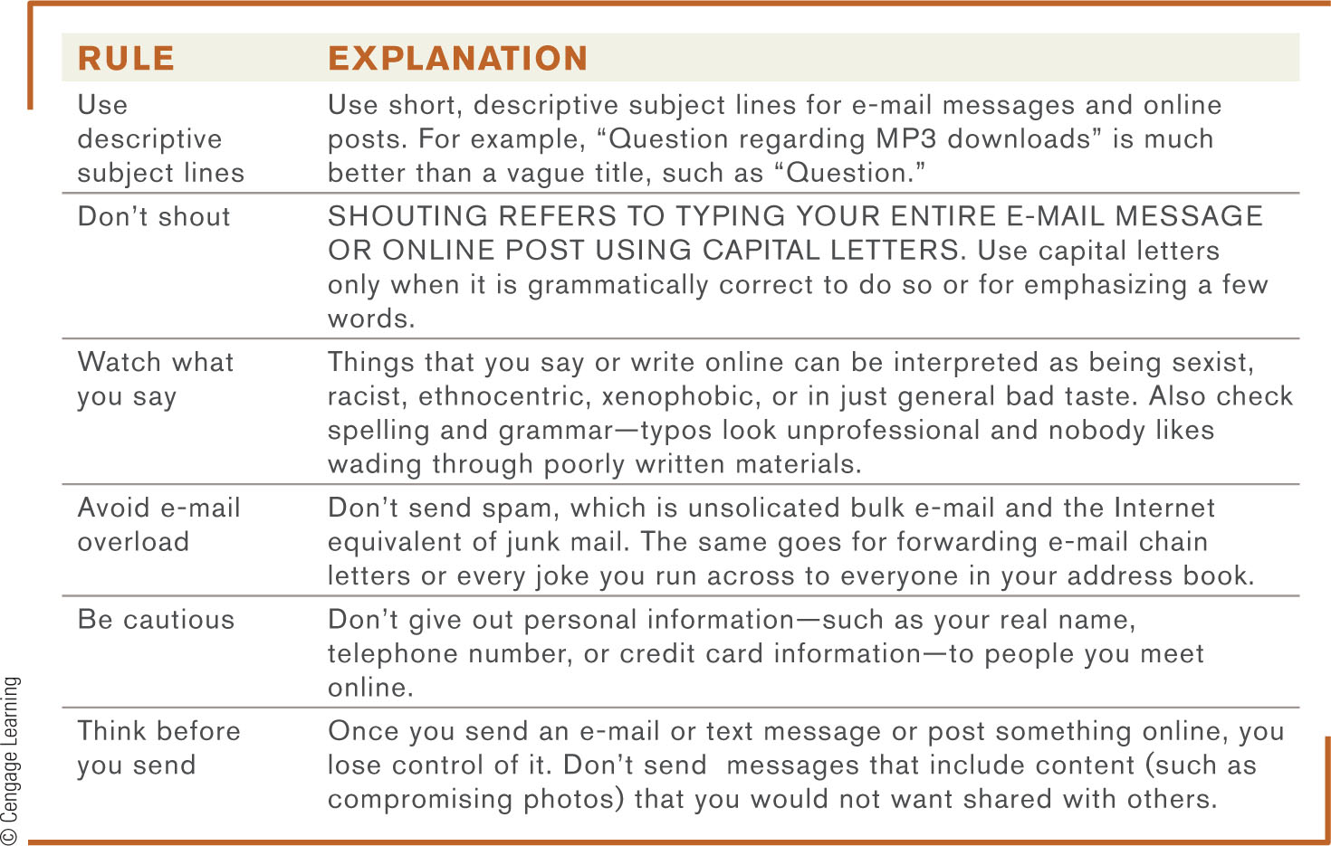
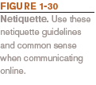
Computers and Society

Slide 68
Computers and Society
The Anonymity Factor
Gives many individuals a sense of freedom
Can also be abused
Information Integrity
Use common sense when evaluating online content
Check your source--not all information on the Internet is accurate

Slide 69
Quick Quiz
1. Index.html is an example of a(n) _____________.
a. URL
b. IP address
c. Web page filename
2. True or False: All information published to Web pages is accurate.
3. In the e-mail address jsmith@abc.com, abc.com is the _____________.
Answers:
1) c; 2) False; 3) domain name

Slide 70
Summary
Computers in Your Life
What is a Computer and What Does It Do?
Computers to Fit Every Need
Computer Networks and the Internet
Computers and Society

